Slide 1
Organizing

Slide 2
Chapter Objectives
Analyze the different forms of an organization
Explain different organizational structures
Describe the differences in Line and Staff relationships
Describe the use and value of teams

Slide 3
Advanced Organizer

Slide 4
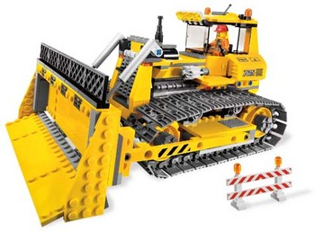
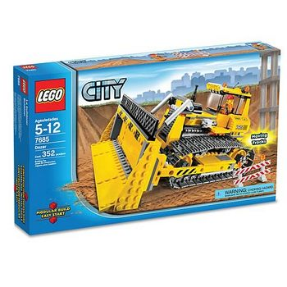
Organizing defined

Slide 5
Organizing defined
Arranging several elements into a purposeful sequential or spatial (or both) order or structure
Assembling required resources to attain organizational objectives

Slide 6
Organizing defined
Organization Role consists of
1
Verifiable Objectives
(from planning)
2
Clear Idea of Major duties
(awareness)
3
Discretion and Authorities
(delegation)

Slide 7
Purpose of Organization
Helps to achieve organizational goal
Optimum use of resources
To perform managerial functions
Facilitates growth and diversification
Human treatment of employees

Slide 8
Nature of organizing
Characteristics of an Organization
Differ greatly in size, function, and makeup. But three characteristics of nearly all organizations with more than a few members are:
(1) a division of labor;
(2) a decision-making structure; and
(3) formal rules and policies

Slide 9
Nature of organizing
Legal forms of Organization
Sole Proprietorship
Partnership
Corporations
Cooperatives

Slide 10
Legal Forms of Organization
Sole Proprietorship
Easy to organize and shutdown
Few legal restrictions
Owner forced/free to make all decisions
Profits taxed once
Owner faces unlimited liability
Duration of business is limited by life of proprietor

Slide 11
Legal Forms of Organization
Partnership
Two or more partners
Easy to organize & relatively few legal restrictions
Pooling of skills
Partners do individual taxes
Unlimited liability for partners, but in limited partnership, at least one unlimited partner and others limited.

Slide 12
Legal Forms of Organization
Corporations
Owned by shareholders
No liability beyond stocks
Taxed twice (corp. tax and personal income tax)
Subject to many state and federal controls

Slide 13
Legal Forms of Organization
Cooperatives
Owned by users and customers
Usually tax free
Ex: Khimti Rural Electric Coop
Trust
Ex: KU

Slide 14
Traditional Organization Theory
Patterns of Departmentation
Basic/primitive: hire few people to work under you.
Functional: hire special mgrs for particular areas like finance, production, sales etc.
Product/Sector: done when functional gets too complicated and chain of command is too long.
Geographic: say, full set for western and eastern coasts. good communication makes this easy.
Mixed

Slide 15
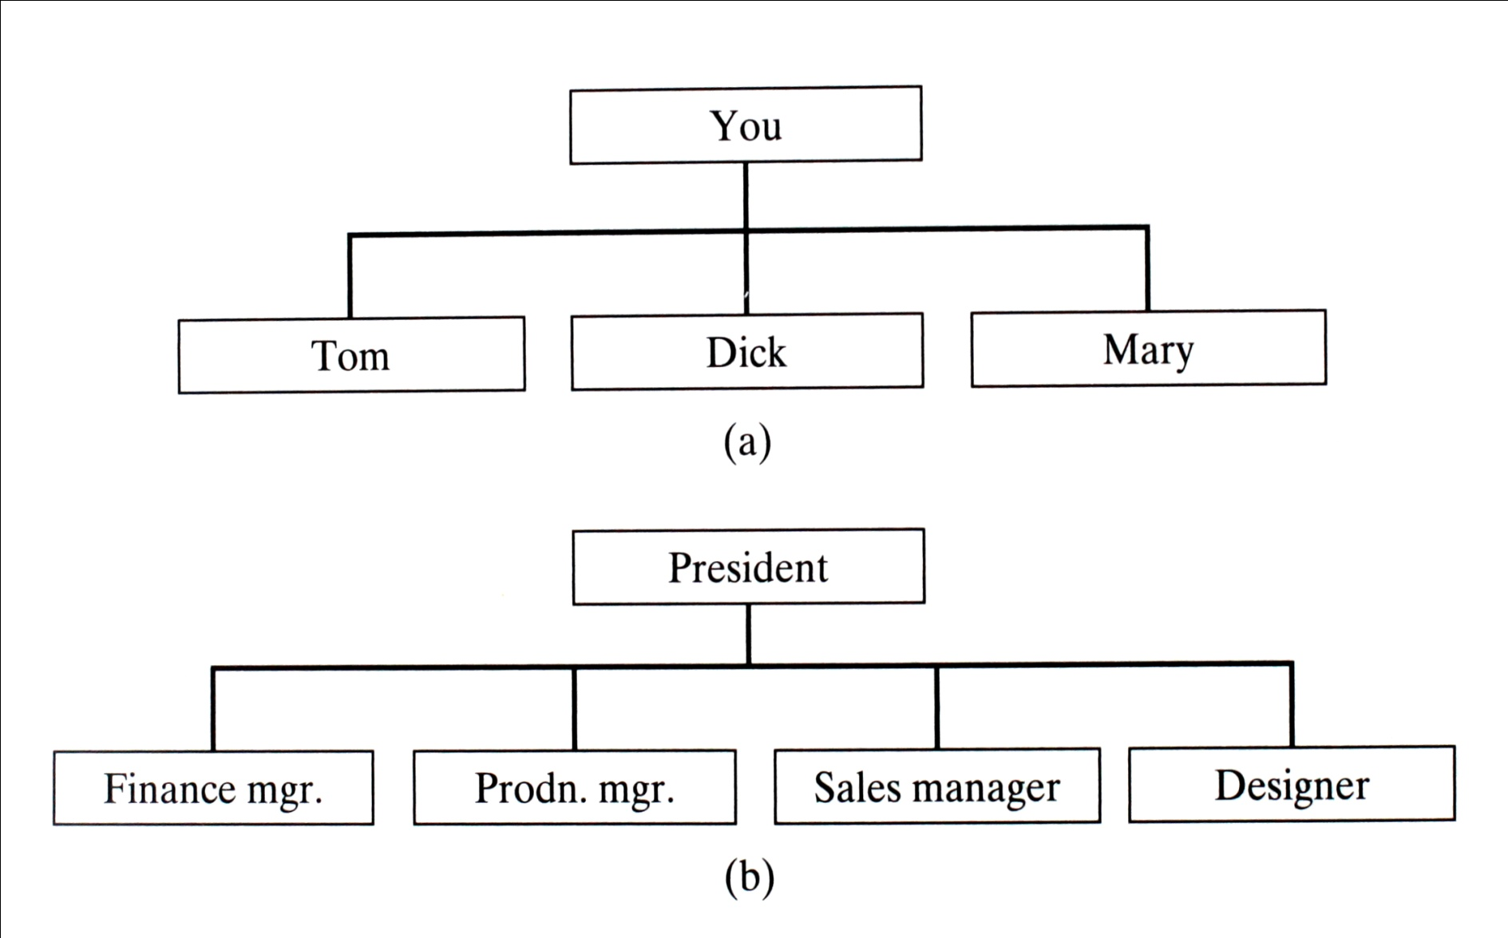
Departmentation
Basic Organization
Functional organization

Slide 16
Basic Organizational Structures
Product Organization
Geographic organization

Slide 17
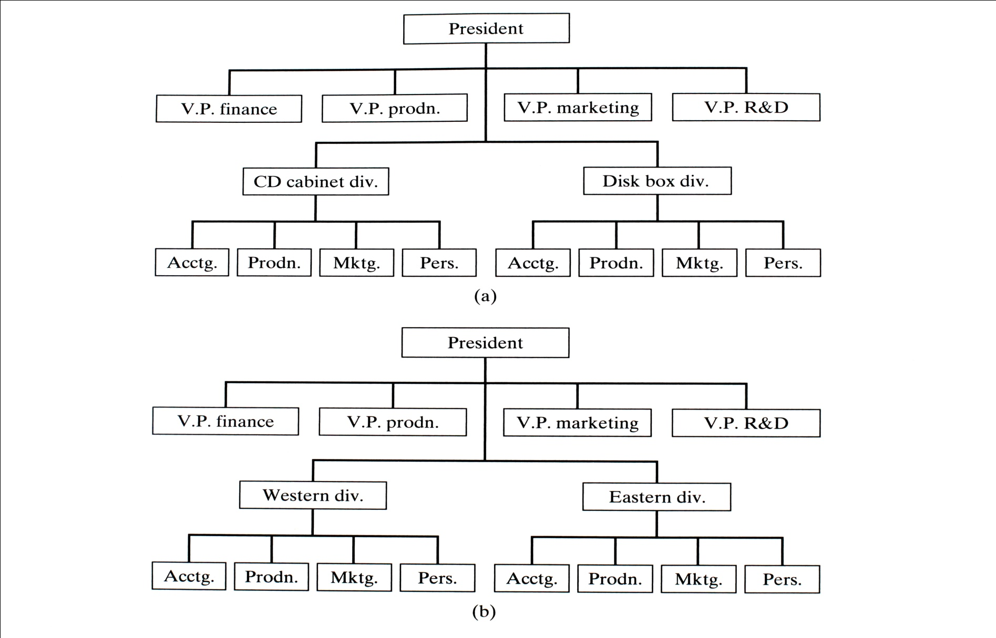

Slide 18
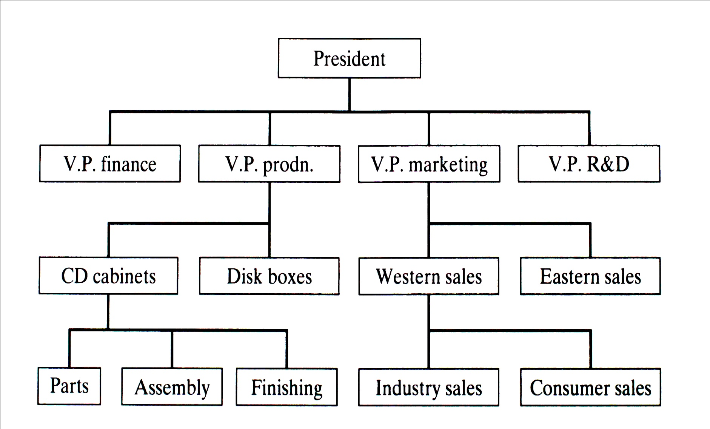
Basic Organizational Structures
Mixed organization

Slide 19
Traditional Organization Theory
Spans of Control
Number of subordinates a supervisor has
In the hierarchical business organization of the past it was not uncommon to see average spans of 1 to 4 or even less.
In the 1980s corporate leaders flattened many organizational structures causing average spans to move closer to 1 to 10.

Slide 20
Traditional Organization Theory
Spans of Control
The current shift to self-directed cross-functional teams and other forms of non-hierarchical structures, have made the concept of span of control less salient.
Theories about the optimum span of control go back to V. A. Graicunas. In 1933 he used assumptions about mental capacity and attention span to develop a set of practical heuristics.

Slide 21
Traditional Organization Theory

Slide 22
Traditional Organization Theory
Spans of Control
Factors determining effective spans
Subordinate training
Nature of jobs
Rate of change of activities and personnel
Clarity of instruction and delegation
Staff assistance

Slide 23
Traditional Organization Theory
Line and Staff Relationships Line functions: those that accomplish the main mission/objectives of the organization.
Staff functions: those that help line accomplish these objectives by providing some kind of service/advice.
Personal staff: `assistant’ to a manager, troubleshoots or does assignments for the manager.
Specialized staff: they serve the entire organization in an area of special competence.

Slide 24
Line and Staff Relationships
Line relationships: Superior/Subordinate relationships typically represented vertically in organizational charts
Staff relationships: Advisory in nature, degree of influence may vary
Provide advice on request
Recommendations when appropriate
Must be consulted by line but have no direct authority
Concurring authority - veto authority over line

Slide 25
Line and Staff Relationships
Service: Centralized support functions
Custodial
Security
Medical

Slide 26
Friction b/w line & staff personnel
Staff specialists: hired from college for degree, little understanding of problems and realities of line organization.
Line managers: usually older, longer tenure in org., less educated and doesn’t understand expertise of staff specialists and need for org.
To solve this in military, officers have assignments in both command and staff.

Slide 27
Teams
Small group of people
Serve interests of its members
Exchange ideas freely and clearly
Have common goals
Committed to achieving goals
Each team member treated equally
Physical and virtual teams: cross boundaries of time, distance and organization, and communicate using technology.

Slide 28
Impact of Information Revolution
Computer
Internet
Intranet

Slide 29
Computer Technology’s Impact on the Work Force
Workers will monitor rather than be a part of production.
Factory workers will require a higher level of skills
Visualization
Conceptual thinking
Knowledge of production process
Statistical inference
Oral and visual communication
Attentiveness
Individual responsibility

Slide 30
Drucker’s list of problems for management w.r.t. info-based org
1. Developing rewards, recognitions and career opportunities for specialists (because promotions decrease the higher one goes up)
2. Unified vision in specialists org.
3. Devise proper mgmt structure.
4. Ensuring supply, preparation and testing of top mgmt people.

